Slide 1

Basic Details of the Team and Problem Statement
Ministry/Organization Name/Student Innovation:
AICTE, MIC-Student Innovation
PS Code: SIH1486
Problem Statement Title: Student Innovation
Team Name: VaayuPrayan
Team Leader Name: RAJGOPAL HOTA
Institute Code (AISHE):UC-0020
Institute Name: Koneru Lakshmaiah Education Foundation
Theme Name: Travel and Tourism

Slide 2
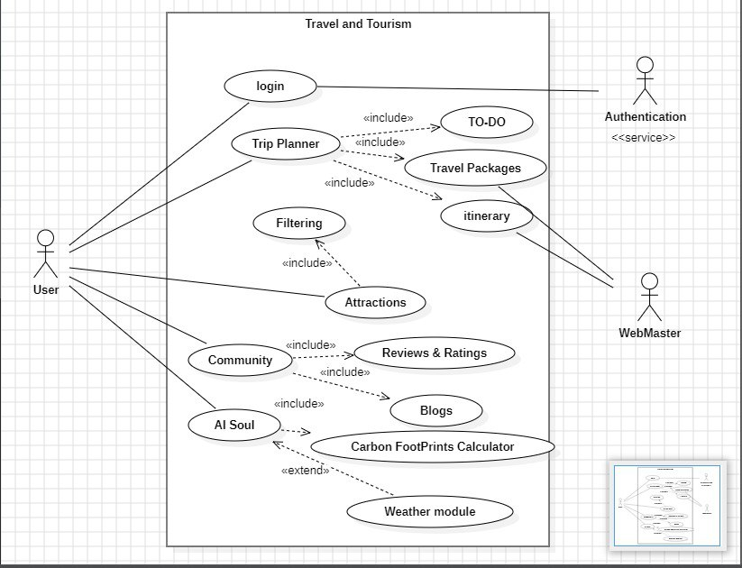









Idea/Approach Details
Use case Diagram:
VaayuPrayan is a travel website that aims to boost travel and tourism throughout India using cutting-edge Web3 technologies. It will be a Progressive Dynamic Web Application (PWA) with a responsive design, making it accessible on any device. It will also feature Metaverse, Augmented Reality, Virtual Reality, Artificial Intelligence (AI) assistance, Optimized voice commands, Content personalization, AI Map locations and distances, Motion UI with trendy designs, AI chat bots, Native cyber security, SinglePageApplication SPA, and Web assembly.
A personalized tourist location feature, powered by Artificial Intelligence (AI) would utilize the user's device location and additional information, like their interests, budget and travel dates to suggest tourist destinations.
Users can earn credits by submitting their 360 AR pics, writing reviews, and sharing their experiences as part of our Loyalty Program, which rewards users for their contributions
The VaayuPrayan Travel Website adopts a microservices architecture and collaborates, with vendors to expand its travel options providing choices, for both businesses and customers resulting in mutual benefits.
The VaayuPrayan Travel App integrates AI voice assistants to enhance travel experiences, with an emphasis on making it easier for individuals with disabilities. It streamlines the travel process by allowing users to book using voice commands and offering up to date information about destinations in time. This inclusive approach guarantees that all users, including those, with mobility challenges, visual impairments or other disabilities can effortlessly access and relish their trips while receiving assistance.
Augmented reality (AR) has the potential to elevate tours by incorporating educational features. For instance, it can superimpose details regarding exhibits. Emphasize noteworthy locations. Furthermore, AR can contribute to a virtual tour experience enabling users to virtually navigate through a hotel room or wander along city streets.
We utilize Natural Language Processing (NLP) to create task lists providing recommendations, for planning an itinerary based on a particular location and timeframe.
Our website employs both blockchain technology and NLP to effectively eliminate paid reviews, ensuring the authenticity and reliability of user-generated content.
Add process flow chart or simulated image of prototype or any relevant image related to your idea
Access website: https://bit.ly/vaayuprayan
Technology Stack:
Frontend: React.js, HTML, CSS, React Native, Bootstrap V5.0
Backend: Node.js, Express.js
Version Control: GitHub
Deployment/Hosting: Netlify, Render, AWS
Data sets: Json, API’s with JSX
Data Base: MongoDB
Package Handlers: npm

Slide 3
Idea/Approach Details
Describe your Use Cases here
Describe your Dependencies / Show stopper here
Our website provides a solution, for all your travel needs enabling you to make reservations for flights, hotels, car rentals, tours and activities. Additionally , it offers details, about destinations encompassing weather updates, popular attractions, dining options, directions and public transportation choices.
Easily create custom travel plans on our platform. Discover selected suggestions, for things to do places to visit and dining choices guaranteeing a trip that suits your individual tastes and desires.
Experience a process, for travel, with convenient Aadhar and documentation support. Our expert guidance will assist you effortlessly through the application process ensuring that all required paperwork and formalities are handled smoothly. Say goodbye to any travel related hassles. Enjoy your journeys hassle
Make your travel experiences even better, with recommendations based on your location. By using geolocation data and advanced AI algorithms we can suggest attractions and dining options that are perfectly suited, to your preferences creating an immersive journey just for you.
Augmented reality (AR) takes tours to the level by adding interactive overlays that provide information, about exhibits and draw attention to interesting points. It creates captivating experiences enabling users to navigate through hotel rooms, city streets and other locations for a virtual tour.
Third-Party API Integration: Integrate APIs for weather updates and location services It Should be accurate
Payment Gateway Integration: Enable secure online payments with Razor pay.
Internet Accessibility : Ensure web accessibility for all users.
Hotel and Transportation facility: Incorporate booking systems for hotels and transportation.
User-friendly Chatbot: Our chatbot guides user 24/7 with multilingual support.
Community :Users can join our community and share their experiences in various forms like comments , likes…
Local vendors communication: We have provided local vendors support to our travelers for more precision.
Personalized suggestions: Users get personalized suggestions from us.
Digitization service: cloud-based app that allows users to store and access digital version of official documents
Digi Locker verification: We need to verify user and access Digi Locker API to validate user for seamless experience of user across the country trip.

Slide 4
Team Member Details
Team Leader Name: RAJGOPAL HOTA
Branch : Btech Stream : CSE Year (I,II,III,IV): III
Team Member 1 Name: RAJA ESHA HARI SHANMUKA RAJENDRA
Branch : Btech Stream : CSE Year (I,II,III,IV): III
Team Member 2 Name: PETETI PAUL KIRAN
Branch : Btech Stream : CSE Year (I,II,III,IV): III
Team Member 3 Name: VYSYARAJU SAI TARUN
Branch : Btech Stream : CSE Year (I,II,III,IV): III
Team Member 4 Name: SACHIDANANDA TRIPATHY
Branch : Btech Stream : CSE Year (I,II,III,IV): III
Team Member 5 Name: PARUCHURI EESHA CHOWDARY
Branch : Btech Stream : CSE Year (I,II,III,IV): III
Team Mentor 1 Name: Dr. K. Ashesh
Category (Academic/Industry): Academic Expertise (AI/ML/Blockchain etc): AI Domain Experience (in years): 7 Years
Team Mentor 2 Name: Type Your Name Here
Category (Academic/Industry): Expertise (AI/ML/Blockchain etc): Domain Experience (in years):

